Slide 1
Policies and Guidelines Governing Appointments, Promotions, and Professional Activities of the
Rutgers Health Faculty
October 25, 2024
Rutgers, The State University of New Jersey

Slide 2
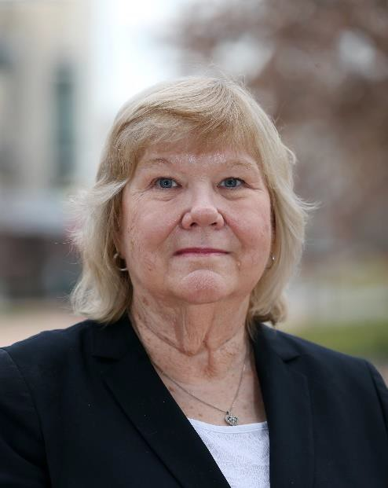
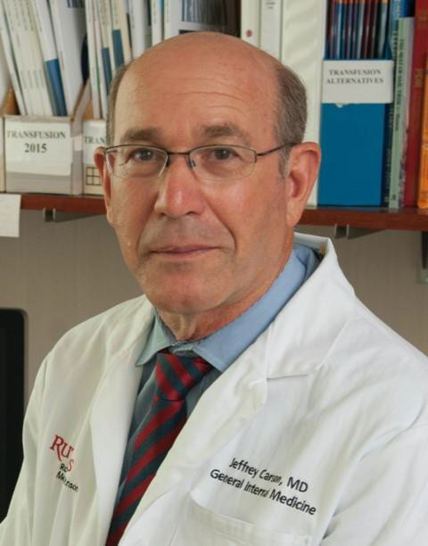
MEET THE PROVOSTS
RBHS
PATRICIA FITZGERALD- BOCARSLY, PHD
JEFFREY
CARSON, MD
Newark Provost
New Brunswick Provost

Slide 3
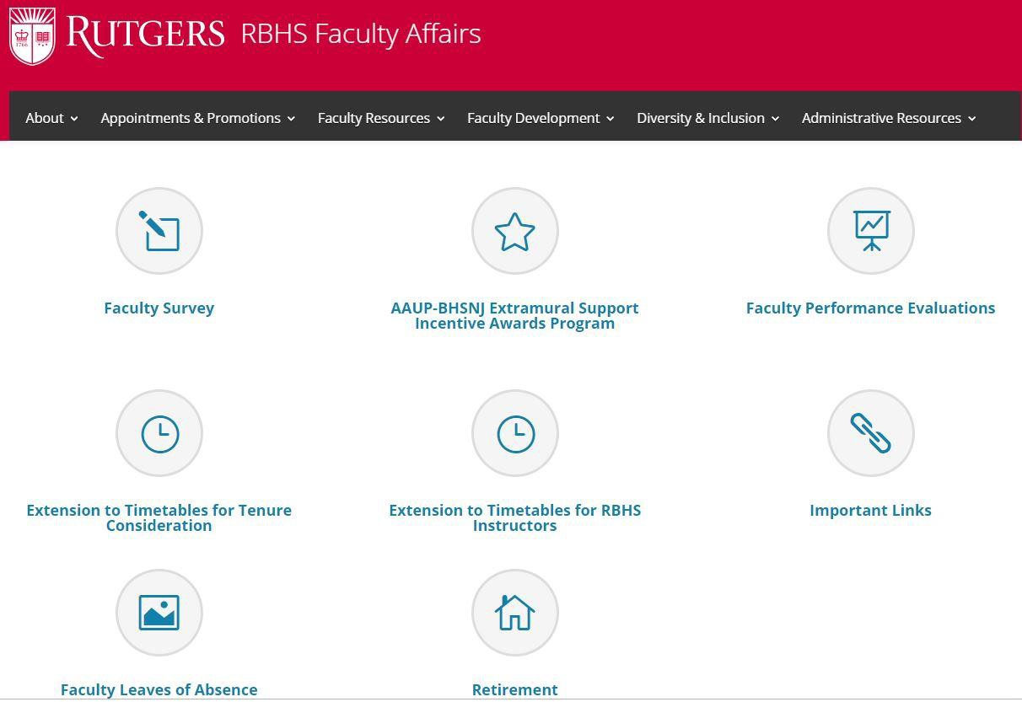
RBHS Faculty Affairs Website
RBHS
https://facultyaffairs.rbhs.rutgers.edu
Faculty Resources

Slide 4

RBHS
A&P Guidelines
https://facultyaffairs.rbhs.rutgers.edu/appointments- promotions/faculty-appointments-and-promotions-guidelines/

Slide 5
Fundamentals
Academic review is required for all reappointments
Teaching is required on all tracks
Professionalism is a must for all faculty
Provosts review appointment letters for whether there is adequate support and mentoring needed for success of proposed faculty member’s mission
Administrators should normally be on scholarly tracks, but in rare instances, may be on the Professional Practice track

Slide 6
RBHS Lecturer
Not assigned a track
For those who have not yet have completed terminal degree
1 to 3 year appointments
May maintain rank for up to 9 years with a 1 year terminal appointment in the 10th year
Once terminal degree is completed, may be considered for promotion to either RBHS Instructor or Assistant Professor

Slide 7
RBHS Instructor
Not assigned a track
Advanced graduate degree or equivalent or completed training and eligible for board certification, if applicable
1 to 3 year terms
By the end of the third (3rd) year, must meet the criteria for promotion to Assistant Professor on one of the five faculty tracks or receive a one-year terminal non-renewable appointment in the fourth year

Slide 8
Selection of Track
Determined at the time of appointment or promotion to Assistant Professor by Department Chair, in consultation with faculty member, Institute Director, Dean, and Provost
Based on:
  Qualifications
  Career aspirations
  Institutional need, availability of position, and funding

Slide 9
Length of Appointments
Non-Tenure Track
Assistant Professor– Teaching, Clinical, Professional Practice
  Initial and reappointments, 1 to 3 years
  After 3 reappointments AND 9 consecutive years: 2-5 year appointment
Research Track – all ranks
Initial and reappointments, 1 to 3 years
After 3 reappointments AND 9 consecutive years: 2-4 year appointment unless the length of the grant/contract to which the faculty is assigned in shorter
Associate Professor–Teaching, Clinical or Professional Practice
  Initial, 1 to 5 years
  Promoted to or reappointment, 2 to 5 years
  After 10 years, 3 to 5 years
Professor and Distinguished Professor-Teaching, Clinical or Professional Practice
  Initial, 1 to 5 years
  Promoted to or reappointment, 3 to 5 years
  After 10 years, 3-7 years

Slide 10
Extension of Timetables
Extensions for Instructors
  Granted in extenuating circumstances
  Request in writing from faculty member
  Must be approved by the chair, dean and provost
Extension for Tenure Track Faculty
  Granted in certain circumstances such as serious health condition, parental or familial circumstances, and/or leave without pay
    Faculty may request up to two years to be excluded but one year at a time (e.g. birth of two children)
    Request in writing from faculty member
      must be approved by the chair, dean, and provosts [we both weigh-in on tenure track actions across both campuses]
Extensions granted in light of COVID-19 for Tenure-Track, RBHS Instructors and RBHS Lecturers
  Depending on date of hire, faculty may have been eligible for up to two years extension.

Slide 11
Faculty Mentoring
Mentoring is a key factor in successful faculty development
Every faculty member up through associate professor is expected to have a mentor to help with their career development
Initially, the mentor may be a chair/supervisor, but within six months, the faculty member should identify a mentor or mentors to help guide their career development
Mentoring of junior faculty is an important faculty role, and is included in the annual review process

Slide 12
Faculty Mentoring, Cont’d.
Mentees must initiate meetings with the mentors on a regular basis (at minimum twice a year); as part of meeting with the mentor, mentees annually should fill out an Individual/Faculty Development Plan and discuss their career development
RBHS, through the Vice Chancellor for Faculty Development, Dr. Maral Mouradian, provides training events for mentors and mentees.
– Events are publicized by email and posted in the RBHS calendar.

Slide 13
The Tracks
Rutgers, The State University of New Jersey

Slide 14
Five full-time tracks designed to ensure collective success of the faculty
Tenure Track
Non-Tenure Tracks
  Research Track
  Clinical Track
    Clinical Scholar
    Clinical Educator
  Teaching Track
  Professional Practice Track

Slide 15
Tenure Track
Faculty will spend majority of time leading investigations
Area of investigation can span any of the disciplines or
modalities related to biomedical sciences, for example:
  Clinical research
  Health services research
  Laboratory research
  Many others
RBHS will provide newly-appointed faculty
  Significant protected time
  Assignment of mentor
  Appropriate start-up funding to conduct research

Slide 16
Tenure Track
Assistant Professor
Must achieve tenure within 9 years, but may do so earlier. If a candidate is not successful by the 9th year, they will be given a one-year non-renewable terminal contract
Normally, assistant professors on the tenure track receive three-year renewable appointments that can be renewed twice - at 3 years after formal review and at 6 years after formal review
Associate Professor
Tenure is customarily granted at the time of promotion to Associate Professor. On occasion, an Assistant Professor on the Tenure Track may be promoted to Associate Professor without granting of tenure after a minimum of four years as Assistant Professor

Slide 17
Tenure Track Cont’d.
Associate Professor and Professor
If a non-tenured Associate Professor or Professor transfers from an outside institution or from a non-tenure track Associate Professor or Professor position from one of the RBHS schools, they will have a total of five years from the time of appointment to receive tenure. If tenure is not awarded by this time, the faculty member will be given a one-year terminal, non-renewable appointment

Slide 18
Award of Tenure
Reserved for faculty members recognized as leaders in their scientific community
  High-impact peer-reviewed publications
  Sustained and substantial peer reviewed funding as PI; e.g., two or renewed R01s or equivalents
  Officer positions in societies, memberships in honorary societies
  Member of editorial boards
  Member of scientific peer review committees
  National or international invited research presentations
  National and/or international reputations attested to by “arm’s length” letters from external referees
    Letters must not be from individuals with personal, training, institutional, or collaborative relationships with candidate

Slide 19
Award of Tenure
Teaching excellence
Clinical excellence (where applicable)
Service
Professionalism

Slide 20
Research Track
Faculty are involved in basic or applied research
The primary focus is to facilitate and support the overall research mission, rather than to develop independent research programs
Faculty typically conduct research in collaboration with other investigators but may have independent laboratories and/or serve as principal investigators on grants and as senior author on publications
Provide the experience, expertise, and leadership needed for the efficient running of core laboratories and the laboratories (including clinical laboratories) of funded research
Teaching responsibilities are primarily related to training lab personnel, work on research projects or use of core facilities.

Slide 21
Research Track Criteria for Promotion
Investigation and scholarly accomplishments
  Authorship of original publications in peer-reviewed journals
  Significant intellectual contributions but not expected to have initiated
and led the research effort
  Contributions to extramural peer-reviewed funding
  Evaluation of unique intellectual contributions by senior authors of
their papers and grants
Evidence of regional and national recognition
  Invitation as a speaker or visiting professor
  Membership and positions of leadership in professional societies
  Editorial board memberships or editorial review assignments
  Consultative positions with various government and private agencies
  Organizer of regional, national, and international meetings

Slide 22
Research Track Criteria for Promotion, Cont’d.
Teaching
  Teaching (including mentoring) in the research laboratory, health professions schools, hospitals, departments, divisions, programs, Graduate School or University activities
Service
  Service is not obligatory and is considered an infrequent event, but
may be considered as a positive factor in promotion
Professionalism

Slide 23
Clinical Track
Evidence of substantial collaborative scholarship, reputation in health care or related fields, patient care and excellence in education and administration, where applicable
Clinical Scholar
  Expected to engage in funded research and publish the results of collaborative research
Clinical Educator
  Not required to have research, but are expected to produce
significant body of scholarly publications
Excellence in health care
Teaching excellence
Service
Professionalism

Slide 24
Clinical Track - Clinical Scholar
Scholarship Requirements
Participate in team research and/or funded research as a significant contributor
Substantial authorship on significant peer-reviewed publications and recognition outside of the institution
In contrast to the tenure track, must make independent contributions with a clear theme, but need not be the leader and driving force
All types of research

Slide 25
Clinical Track - Clinical Educator
Scholarship Requirements
Requires nationally recognized scholarship
– Peer-reviewed and non-reviewed publications including reviews, textbook chapters, case series, case reports, published practice guidelines, meta-analyses, or other examples of scholarly contributions
No research requirement but will be considered if present
Criteria** categories are not a checklist for promotion; advancement is based on a holistic approach/process evaluating the totality and level of achievements.
**RBHS Criteria for promotion to Associate Professor or higher

Slide 26
Clinical Track Promotion Criteria
Clinical Excellence
  Outstanding clinicians in their respective fields (required)
  Receive referrals (where applicable) of challenging clinical problems or have unique clinical expertise
  Clinical care that is regarded as outstanding
    Based on opinions of senior faculty members, other physicians
and/or health professionals, and trainees
Teaching Excellence
  Can take many forms including documented curriculum and course development, training, teaching and advising students, residents, fellows and colleagues through mentoring
  Can be in multiple settings, including classroom, online, laboratories,
in/outpatient and community

Slide 27
Clinical Track
Promotion Criteria, Cont’d.
Scholarly Activities
  Focused on specific area of interest and represent a theme(s) of work and be nationally accessible
  Clinical Scholar:
    Independent intellectual contributions to a supported research program
    Need not be the leader and driving force behind a body of work; however, research performed should be high quality and demonstrated by:
– Publications; presentations at national meetings; recognition on a national level
  Clinical Educator: not required to participate in research, but must produce significant volume of scholarly publications
    Peer-reviewed manuscripts, practice guidelines and articles; book chapters; case reports; consensus reports; development of innovative teaching materials, curricular or teaching methods; approaches to or contributions to research

Slide 28
Clinical Track
Promotion Criteria, Cont’d.
Administration (if applicable)
  Successes in the outcomes of the programs administered
  Innovation, quality improvement and scholarship regarding administration of programs
  Local, regional or national recognition
Service to Medical Center, University, Community
  Administration, if applicable, or service on committees
  Memberships in organizations and societies
  Grant review panels
  Community service activities, beyond those done as part of their
normal funded faculty roles

Slide 29
Clinical Track
Promotion Criteria, Cont’d.
Additional Criteria** for Clinical Educator
  Active participation in mentoring is expected
  Quality Improvement (QI) initiatives are desirable; leadership
  Demonstrated engagement in Diversity, Equity, and Inclusion
programming and self-development activities
**RBHS Criteria for promotion to Associate Professor or higher: Table-for-Criteria-NTT-Tracks-FINAL-052024.pdf (rutgers.edu)

Slide 30
Teaching Track
Education leader
Evidence of outstanding contributions to teaching
  Publication of teaching methods and materials
  Creation of outstanding continuing education and teaching programs
Assemble, maintain, update an educator’s portfolio/dossier
  Regional/nationally recognized scholarship for their educational
accomplishments but may publish on non-educational topics as well
  Published, peer-reviewed papers on education, textbooks
  Invited talks
  Memberships in program review or accreditation committees, etc.
Excellence in patient care and administration, if applicable
Professionalism

Slide 31
Teaching Track Promotion Criteria
Teaching Excellence
  Can take many forms including curriculum and course development, training, teaching and advising students, residents, fellows and colleagues through mentoring
  Can be in multiple settings, including classroom, online, laboratories, in/outpatient and community
Scholarly Activities
  Focused on specific area of education, should be a theme(s) of peer reviewed work and nationally accessible and recognized
  Appropriate activities include:
    Publication of case reports/series, educational materials, scholarly reviews, book chapters or textbook authorship or editorship, creation of novel computer programs, development of innovative teaching materials

Slide 32
Teaching Track
Promotion Criteria, Cont’d.
Clinical Excellence (where applicable)
  Outstanding healthcare providers in their respective fields
  Receive referrals (where applicable) of challenging healthcare problems
  Clinical care that is regarded as outstanding
    Based on opinions of senior faculty members, other physicians and/or health professionals, and trainees
Administration (if applicable)
  Successes in the outcomes of the programs administered
  Innovation, quality improvement and scholarship regarding the administration of programs
  Local, regional or national recognition

Slide 33
Teaching Track
Promotion Criteria, Cont’d.
Evidence of regional and national recognition
  Invitation as a speaker or visiting professor
  Membership and positions of leadership in professional societies
  Editorial board memberships or editorial review assignments
  Consultative positions with government and private agencies
  Organizer of regional, national, and international meetings
Service to Medical Center, University, Community
  Memberships in organizations and societies
  Grant review panels
  Community service activities beyond those done as part of their normal funded faculty roles

Slide 34
Teaching Track
Promotion Criteria, Cont’d.
Additional Criteria** for Teaching Track
  Active participation in mentoring is expected
  Quality Improvement (QI) initiatives/innovation is desirable; leadership
  Demonstrated engagement in Diversity, Equity, and Inclusion programming and self-development activities
**RBHS Criteria for promotion to Associate Professor or higher: Table-for-Criteria-NTT-Tracks-FINAL-052024.pdf (rutgers.edu)

Slide 35
Professional Practice Track
Superior healthcare skills
Recognition and involvement in teaching
Collaborative participation in ongoing clinical and translational research programs preferably leading to scholarly output

Slide 36
Professional Practice Track Promotion Criteria
Clinical Excellence
  Outstanding clinicians in their respective fields with a regional or national
reputation
  Receive referrals (where applicable) of challenging clinical problems or have unique clinical expertise
  Clinical care that is regarded as outstanding
    Based on opinions of senior faculty members, other physicians and/or health professionals, and trainees
Teaching Excellence
  Involvement in curriculum and course development and teaching
students, residents, and fellows
  Mentoring students or residents in preparation of abstracts, case reports or review articles
  Teaching awards
  Invited lectures

Slide 37
Professional Practice Track Promotion Criteria, Cont’d.
Scholarly Activities
  Strongly encouraged and will be considered in promotion decisions
  Expected to provide a supportive role in clinical research
    Include enrolling patients in clinical trials, interpretation of images
or of anatomic samples in clinical research, etc.
    Achievement needs to be documented, although may not be at the level recognized by co-authorship
Service to Medical Center, University, Community
  Administration, if applicable, or service on committees
  Clinical laboratory program
  Community service activities, beyond those done as part of their
normal funded faculty roles

Slide 38
Professional Practice Track Promotion Criteria, Cont’d.
Additional Criteria** for Professional Practice Track
  Active participation in mentoring is expected
  Quality Improvement (QI) initiatives/innovation is desirable; leadership
  Demonstrated engagement in Diversity, Equity, and Inclusion programming and self-development activities
**RBHS Criteria for promotion to Associate Professor or higher: Table-for-Criteria-NTT-Tracks-FINAL-052024.pdf (rutgers.edu)

Slide 39
Criteria Teaching, CE, PPT, CFUPs, and VCFs Promotions
During FY22 and FY23, the Provosts reviewed the criteria for promotion on the Clinical Educator track and Teaching track, which included seeking feedback from leadership and faculty and produced a table with updated guidance (see link below). During FY24, they will conduct the same review of the Research and Clinical Scholar tracks.
The document below lists the categories that will be evaluated while in rank for promotion in the Teaching Track, Research Track, Clinical Scholar Track (CS), Clinical Educator Track (CE), Professional Practice Track (PP), and for Clinically Focused University Practitioners (CFUP) and Voluntary Clinical Faculty (VCF).
RBHS Criteria for Promotion to Associate Professor and from Associate
Professor to Professor

Slide 40
Additional Resources
RBHS Promotions Data
The documents below can only be accessed by entering your Rutgers credentials. After clicking the link to the document, you will be directed to Microsoft 365 to login with the RU credentials.
RBHS Definition for R01 Equivalents
The purpose of this document is to provide clarification on what qualifies as an NIH R01 equivalent, as related to the RBHS Policies and Guidelines Governing Appointments, Promotions, and Professional Activities of the Faculty (A&P Guidelines); these Guidelines require “sustained and substantial peer-reviewed extramural support” for promotion on the tenure track and award of tenure. Note that for schools/units following the AAUP-AFT guidelines, which provides for a shorter tenure-track period than that in the AAUP-BHSNJ Guidelines, the length of the pre-tenure period will be taken into account in assessing productivity of the faculty member. Importantly, this document is not meant to be all-inclusive of every possible grant mechanism that may be considered, but rather to provide guidance as to examples of types of grants that will be considered as R01 equivalents.

Slide 41
Transfer Between Tracks
Rutgers, The State University of New Jersey

Slide 42
Transfer Between Tracks
Transfers between tracks should be rare.
– Changes are considered in circumstances where there is a change in the direction of the faculty member’s career.
Transfers between tracks require the written request of the faculty member specifying the track into which they want to transfer and approvals by:
‒ | Department Chair | ‒ | Provost
‒ | A&P Committee | ‒ | Chancellor
‒ | Dean
Upon approval of a transfer between tracks, a letter outlining the terms of the appointment on the new track will be provided to the faculty member.
Faculty with questions about changing tracks should discuss with their Chair and/or Provost.

Slide 43
Rutgers Health Statement on Professionalism in the Workplace
Rutgers, The State University of New Jersey

Slide 44
Professionalism Statement
Rutgers Health is committed to (1) providing exceptional health care, education and training, research, and discovery for the people of New Jersey and beyond; (2) serving as a distinguished national model for health care access and quality, research and innovation, interprofessional education and healthcare, and community service and engagement; and (3) showing dedication to respect, collaboration, inclusion, excellence, innovation, and accountability in all that we do. This commitment reflects our mission, vision, and values, and it requires us to conduct ourselves with integrity, ethics, and professionalism, and to create an environment of care and respect for colleagues, patients, and visitors alike.
While not an exhaustive list, this Statement on Professionalism (“Statement”) provides general guidance regarding the University’s and Rutgers Health’s expectations for professionalism in the workplace. Employees (including students serving as employees or functioning in a clinical setting) are required to familiarize themselves not just with this Statement, but with the policies and resources referenced in this Statement (many of which are referenced below) and adhere to these values and principles in the workplace at all times. In the event of any conflict between this Statement and a University Policy or collective negotiations agreement, the University Policy or collective negotiations agreement shall govern.
This Statement is founded upon and incorporates our established values and principles and is reflected in existing University Policies and Rutgers Health policies, statements, and other official guidance. Your commitment to following these standards ensures that Rutgers Health will continue to provide excellent patient care, encourage innovations in education, create a supportive learning environment, and conduct ground-breaking research while ensuring a safe, respectful, and professional workplace for all.
The full Statement on Professionalism in the Workplace can be accessed here: Rutgers-Health_Statement-Professionalism_073024.pdf (rutgershealth.org)

Slide 45
Mentorship and Mentee Trainings
There are two upcoming sessions for mentors and mentees sponsored by the Vice Chancellor for Faculty Development:
You are invited to “How to be an Effective Mentee,” presented by M. Maral Mouradian MD, Vice Chancellor for Faculty Development.
Event Details: November 12, 2024 from 12:00 to 1:00 pm via Zoom
Join us to learn:
Why mentoring matters
The four pillars of effective mentoring
Mentees responsibilities
Register here: How to Be an Effective Mentee Virtual Workshop (office.com)
We’re delighted to invite you to our upcoming workshop, “Mentoring: A Pathway to Productivity,” by Anita Siu, PharmD, and Andrew Gow, PhD. This workshop will engage participants in developing their skills as mentors to guide their mentees' productivity. It will include a presentation of best practices and strategies as well as hands-on case study activities.
  November 18, 2024 from 12 pm – 2 pm via Zoom
  Register here

Slide 46
Contact Us!
Provosts:
Newark, Patricia Fitzgerald-Bocarsly: bocarsly@njms.rutgers.edu
New Brunswick, Jeffrey Carson: jeffrey.carson@rutgers.edu
RBHS Faculty Affairs:
rbhsfacultyaffairs@rbhs.rutgers.edu or 973-972-7595
Rutgers, The State University of New Jersey

