Slide 1
Rutgers Health Faculty Search Committee Training Updated Summer 2025

Slide 2
Roadmap
Introduction
Search Committee Charge
General Expectations
Important Considerations
Mitigating Bias in process
Outreach for Broad Applicant Pools
Policies and Procedures
Managing Searches
Advertising and Recruitment
Review of Applications
Interviews and Campus Visits
Presenting the Finalists
Resources

Slide 3
Introduction
Search Committees:
Play an important role in recruiting and shaping Rutgers Health faculty
Have the ability to make substantive changes at Rutgers Health and the University by helping to recruit faculty that represent our high standards of excellence and our inclusive culture
Contribute to and enhance the image of Rutgers Health and the University
Notes:
Search committees play an important role in recruiting and shaping RBHS faculty. They have the ability to make substantive changes at RBHS and the University by helping to recruit faculty that represent our high standards of excellence.
In addition, the search committee is in a unique position to contribute to and enhance the image of RBHS and the University. While the search committee is evaluating candidates, the candidates are also evaluating the search committee, the department, school, and, ultimately, the institution. In order for candidates to have a positive image of RBHS and the University, the search committee must pay attention to the details of the search process.

Slide 4
Introductions and Engagement Activity
Introduce yourself
Name, Rank/Title, School/Department
What are the elements of a good search?
Notes:
Internal notes:
Have each member introduce themselves with their name, rank/title and school/department and answer the question “What are the elements of a good search?” Let the committee members discuss this, interjecting where needed. The point of this exercise is to ascertain some baseline information from the committee about their thoughts on what is required for a good search. This can be used to establish common ground later in the training.
The excerpt below is FYI and is adapted from Eve Fine and Jo Handelsman, Searching for Excellence & Diversity: A Guide for Search Committees, National Edition (Copyright © 2012 by WISELI and The Board of Regents of the University of Wisconsin System) https://wiseli.wisc.edu/wp-content/uploads/sites/662/2018/11/SearchBook_Wisc.pdf
“Active involvement of every member of the committee can help you reach a broad base of potential candidates. To generate active participation, set the tone in the first meeting. In productive search committees, the committee members feel that their work is important, that each of them has an essential role in the process, and that their involvement in the search process will make a difference. Some tips include:
Begin with brief introductions to get your committee talking and comfortable with each other. The assumption that members already know one another may not be correct—particularly if the search committee includes a student representative or members from outside the department.
Be enthusiastic about the position, potential candidate pool, and composition of the search committee.
Remind committee members that in this age of tight budgets each position is precious and that it is up to them to ensure that the best candidate is in the pool.
Explain that the search process is far more idiosyncratic and creative than the screening process and stress that committee members can put their individual stamp on the process by shaping the pool.
Appreciate each committee member for the critical role he or she is playing by helping to select future faculty who will represent the department and the university for years to come.”

Slide 5
General Expectations
Attendance – Search members are required to attend all search committee meetings and activities.
Confidentiality – Keep all materials and proceedings related to the search committee confidential during and after the search.
Voting – Decide, ahead of time, if voting will be unanimous or majority, if you will allow absentee votes, or confidential ballots. Confidential voting is a best practice because it protects vulnerable faculty from undue influence, allows for each voice to be heard, and can reduce inter-departmental disagreements.
Notes:
Other ground rules should be included on this slide as appropriate
Below are excerpts from Eve Fine and Jo Handelsman, Searching for Excellence & Diversity: A Guide for Search Committees, National Edition (Copyright © 2012 by WISELI and The Board of Regents of the University of Wisconsin System)
Discuss and establish ground rules for the committee. Be explicit. Don’t make the assumption that people already have the information.
Decision-making - How will the committee make decisions? By consensus? By voting? Who are the voting members? It is important to determine this at the outset
Confidentiality

Slide 6
Important General Considerations
Understanding and mitigating any bias in search processes

Slide 7
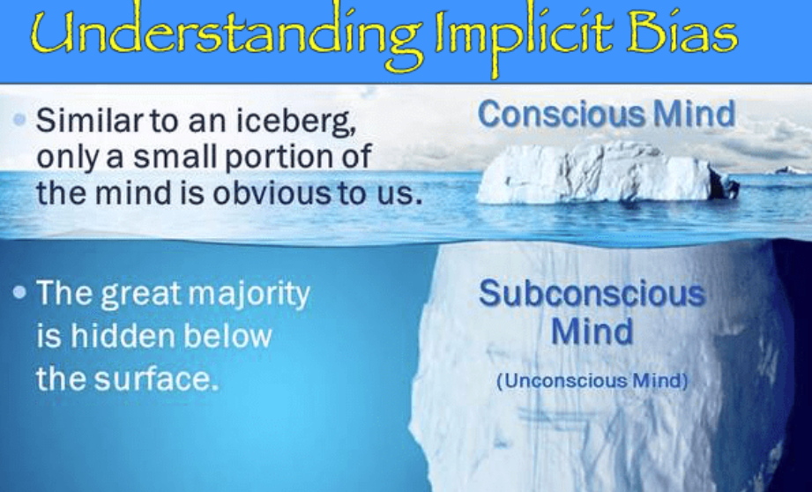
Bias
“We do not see the world as the world as it is. We see the world as we are.” ~Talmud
Unconscious or Implicit Bias is a process the brain uses such that "mental associations that are so well-established can operate without awareness, or without intention, or without control."
Source: Project Implicit, Harvard University
Notes:
Gita

Slide 8




Brain Schemas Can Impact Decisions
SCHEMAS:
Mental images or prototypes that we cognitively construct based on what we observe around us about any difference; e.g., gender, ability, etc.
Assumptions
And expectations about people that impact judgement
Cognitive Short-cuts
Help process information fast BUT prone to cognitive errors
Ubiquitious
We ALL, perceive people differently based on social groups to which we (and they) belong
Sources: Krosnick et al, 2021; Greenwald, Poehlman, Uhlmann, and Banaji, 2009;
Jost, 2019; Greenwald and Banaji, 2017
Notes:
These structural problems are compounded by schemas that we all form.a Framework is rooted in psychology: here is a simplified overview. Schemas are a way to think fast, and we need and rely on them on a daily basis. Example is from a children’s book from 1950’s (read). Vast majority of Americans hold implicit associations and stereotypes. The Implicit Association Test: A simple and convincing way to explore the effects of your own schemas.

Slide 9

Literature Reveals an Impact on Our Decisions
Example 1: Unconscious Evaluation Bias in CVs and more
Unintentionally favoring or disfavoring others based on schemas held about a group
Resume study example:
Male post-doc candidates rated as more competent and hireable than female candidates;
White and Asian candidates rated as more competent and hireable than Black and Latinx candidates
School attended
Advisor’s reputation
Area of specialization
Source: Eaton et al. (2020)
Notes:
These structural problems are compounded by schemas that we all form.a Framework is rooted in psychology: here is a simplified overview. Schemas are a way to think fast, and we need and rely on them on a daily basis. Example is from a children’s book from 1950’s (read). Vast majority of Americans hold implicit associations and stereotypes. The Implicit Association Test: A simple and convincing way to explore the effects of your own schemas.

Slide 10
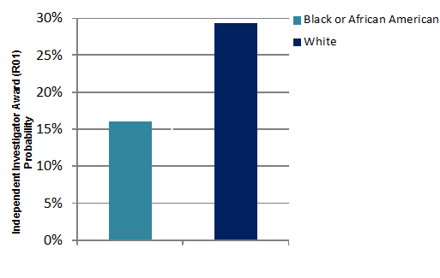
Literature Example 2:
Evaluations of Grant Applications
Disparities in Grant Success
83,188 NIH grant applications from 40,069 individuals from 2000-2006.
Differences in funding rate remained after controlling for education and training, previous NIH experience, research productivity, and other relevant factors.
Results led to major review and reform of processes by NIH.
Sources: Ginther et al., (2011). Science, 333, 1015-1019; Wenneras & Wold (1997). Nature, 387, 341-343 (classic study on gender bias in grants)
Notes:
These structural problems are compounded by schemas that we all form.a Framework is rooted in psychology: here is a simplified overview. Schemas are a way to think fast, and we need and rely on them on a daily basis. Example is from a children’s book from 1950’s (read). Vast majority of Americans hold implicit associations and stereotypes. The Implicit Association Test: A simple and convincing way to explore the effects of your own schemas.

Slide 11
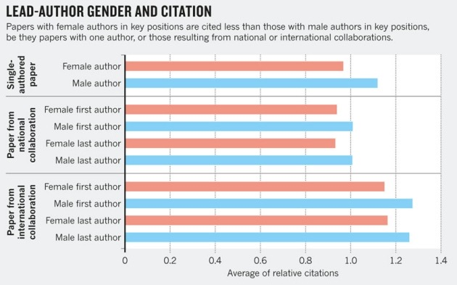
Example 3: Who Gets Cited
No Matter Who Led the Research
Citation patterns favor male authors
Female authors in key positions cited less than similarly situated male authors
Author names inferred to be male were given higher ratings and viewed as more scientific
Sources: Larivière et al. (2013); Maliniak et al. (2013)
Notes:
These structural problems are compounded by schemas that we all form.a Framework is rooted in psychology: here is a simplified overview. Schemas are a way to think fast, and we need and rely on them on a daily basis. Example is from a children’s book from 1950’s (read). Vast majority of Americans hold implicit associations and stereotypes. The Implicit Association Test: A simple and convincing way to explore the effects of your own schemas.

Slide 12
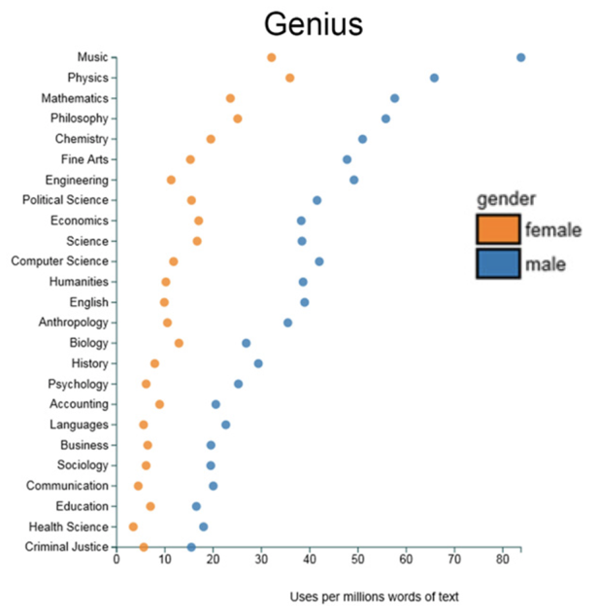

Example 4: Teaching evaluations
14 million reviews from RateMyProfessor.com
Perceptions of Instructors across Disciplines Often Favor Males
Source: http://benschmidt.org/profGender/
Notes:
These structural problems are compounded by schemas that we all form.a Framework is rooted in psychology: here is a simplified overview. Schemas are a way to think fast, and we need and rely on them on a daily basis. Example is from a children’s book from 1950’s (read). Vast majority of Americans hold implicit associations and stereotypes. The Implicit Association Test: A simple and convincing way to explore the effects of your own schemas.

Slide 13

Example 5: Impact on Letters of Recommendation
How people write Letters of Recommendation for different groups, one example is:
For men:
Longer
Repetition of standout adjectives (outstanding, excellent, etc.)
More references to CV, publications, patients, colleagues
For women:
Shorter
Use of “grindstone” adjectives (conscientious, meticulous, hard- working)
More references to personal life
More “doubt raisers” (hedges, faint praise, and irrelevancies: “She is close to my wife”)
Sources: Trix & Psenka, 2003; Dutt et al., 2016; Kervyn, et al., 2012; Kuncel et al., 2014; Madera et al. 2019; Schmader, et al., 2007.
Notes:
These structural problems are compounded by schemas that we all form.a Framework is rooted in psychology: here is a simplified overview. Schemas are a way to think fast, and we need and rely on them on a daily basis. Example is from a children’s book from 1950’s (read). Vast majority of Americans hold implicit associations and stereotypes. The Implicit Association Test: A simple and convincing way to explore the effects of your own schemas.

Slide 14

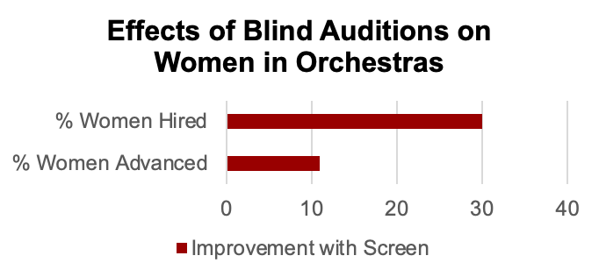
Example 6: Procedures Can Affect Outcomes
Many US symphony orchestras changed their selection outcomes by using blind auditions starting in 1970s.
Blind auditions increased the proportion of women new hires by about 30%
Blind auditions increased the proportion of women advanced from preliminary rounds by 11%
Notes:
These structural problems are compounded by schemas that we all form.a Framework is rooted in psychology: here is a simplified overview. Schemas are a way to think fast, and we need and rely on them on a daily basis. Example is from a children’s book from 1950’s (read). Vast majority of Americans hold implicit associations and stereotypes. The Implicit Association Test: A simple and convincing way to explore the effects of your own schemas.

Slide 15
Procedural Framework for Search Committees
Equitable policies consistently applied:
Commitment to acknowledging and reducing the influence of any bias
Establish plan for active recruitment and outreach to ALL groups
Discuss and agree upon objective and uniform process prior to recruitment
Discuss and agree upon clear criteria for evaluation, selection, interviews and voting
Avoid ranking or labeling candidates until after the interviews.
Read the recommendation letters with an eye toward potential “letter-writer bias” that predominantly affects candidates from different backgrounds
Notes:
The most important factor in reducing bias is starting from the knowledge that we all have unconscious biases.
We are human and humans have cognitive errors.
If we accept that this is true it is easier to commit to implementing those actions that reduce the influence of those biases like insisting on well-reasoned evidence for opinions rather than general feelings or biased assertions.
The actions we have discussed today have been well researched and are accepted best practices or promising practices.

Slide 16
THE SEARCH PROCESS

Slide 17
Search Committee Charge: Search Details
Position(s) to be filled – rank(s)/title(s)
Scope of the search – internal, local, national or international
Deadlines
Discuss any unique factors or history regarding this search (i.e. a reposted position, challenges during prior recruitments, challenges within the department/school)

Slide 18
Advertising and Recruitment
The search committee may participate in the development of the job description.
The search committee may suggest venues, or additional venues, for advertisement of the position.
The search committee actively participates in the search process, not just the selection process.
Members shall contact professional organizations, colleagues, prior students, and other contacts to spread the word about the position.
Members share input on where the position should be advertised in order to attract the most diverse pool of candidates possible.
*Note: The ROCS link should be included in all outside postings/announcements.

Slide 19
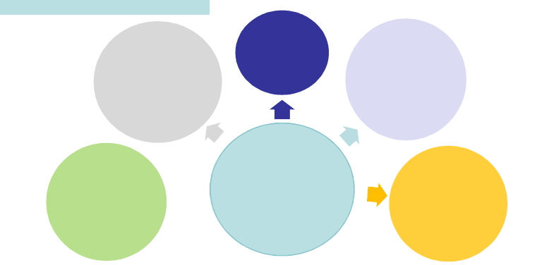
Strategies for Continuous Search
Post job
ad in disciplinary publication
Recruit year round at meetings and conferences
Leverage Social Media
SEARCH IS A VERB:
MAKE YOUR SEARCH ACTIVE!
Establish relations with promising junior faculty elsewhere
Widen your pool to a broad set of institutions
Notes:
These structural problems are compounded by schemas that we all form.a Framework is rooted in psychology: here is a simplified overview. Schemas are a way to think fast, and we need and rely on them on a daily basis. Example is from a children’s book from 1950’s (read). Vast majority of Americans hold implicit associations and stereotypes. The Implicit Association Test: A simple and convincing way to explore the effects of your own schemas.

Slide 20
Review of Applications
Starting with the criteria in the position description, the committee should discuss and agree on how it will define and weigh competencies and qualifications.
Creating an evaluation matrix or rubric will streamline the initial review of candidates. (Example: HERC Evaluation Template)
Discuss expectations around how many candidates should be presented to the hiring officer for review.
Review applications and select candidate for interview.
Notes:
Note: You have to be logged into HERC in order to access the HERC Applicant Evaluation Template. Rutgers is a member of HERC. You can request an account using your Rutgers email address if you do not have a HERC account.

Slide 21



Conditions That Can Hinder Reviews
Stress from competing tasks
Time pressure
Ambiguity/incomplete information
Lack of critical mass (solo status)
Present in faculty searches
. . . all of which can influence decision making.
Sources: Devine et al., 2017; Greenwald & Lai, 2020; Hahn & Gawronski, 2019; Hunzaker et al., 2016; Koriat et al, 2000; Melamed et al, 2019; Stewart & Valian (2018)

Slide 22
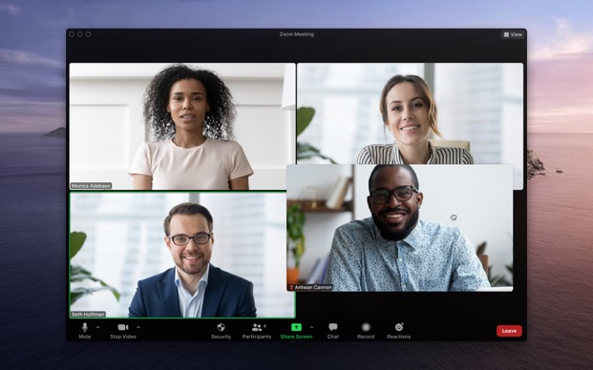
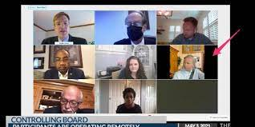
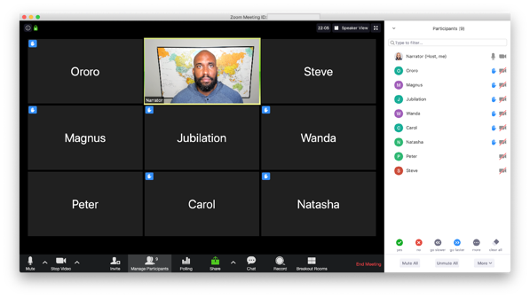
Which Cues in a Remote Visit
Are Most Welcoming?
Notes:
These structural problems are compounded by schemas that we all form.a Framework is rooted in psychology: here is a simplified overview. Schemas are a way to think fast, and we need and rely on them on a daily basis. Example is from a children’s book from 1950’s (read). Vast majority of Americans hold implicit associations and stereotypes. The Implicit Association Test: A simple and convincing way to explore the effects of your own schemas.

Slide 23
Interviews and Campus Visits
Goals of the interview process:
To gather information about candidates
Create a positive image of the department, school, and Rutgers Health
Present a realistic description of the position
Ensure that all applicants have been treated fairly
Establish adequate records in the event the selection decision must be justified
To select qualified candidates to present to the hiring officer
Ensure equitable treatment of all candidates with consistency in scheduling logistics, information, meals, transportation, lodging, and campus tours.
Ask candidates who, if anyone, they would like to meet outside your department/unit.
Let them take the lead in identifying if they would like to speak with, perhaps other women faculty or faculty from other affinity groups, potential collaborators, etc.

Slide 24
Interviews and Campus Visits
Decide on the interview format for candidates.
Initial interviews may be done in-person or by videoconference or telephone, but all initial interviews should follow the same format.
It is generally required that final interviews be conducted in-person.
During the final interviews, this may include additional meetings with RU faculty, deans, and leadership.
Determine what materials and information will be provided to the candidates in advance of the interview process.
Select mechanism for uniformly ranking interviewed candidates.
Create a uniform set of questions to ask each candidate. Questions may be tailored to the candidate when appropriate (e.g., research agenda).
Notes:
May want to add any special considerations given COVID-19

Slide 25
Interviews and Campus Visits
Reasonable accommodations for interviews are part of the UHR Hiring Tool Kit in the “AA/EEO Guidelines for Recruitment and Selection” section.
Reasonable accommodations may be required for the following:
Interviewing individuals with disabilities
Interviewing individuals with religious needs
Reasonable accommodations for interviewing are available online:
https://uhr.rutgers.edu/sites/default/files/userfiles/RecruitmentSelectionGuidelines.docx

Slide 26
Consistency in Interviewing
Maintain consistency by providing a matrix or rubric for all colleagues to record their impressions of each candidate they interview or meet at a talk or meal.
Use the interview process to explore the talents that diverse individuals have to offer.
Review resources for asking appropriate questions legally. (See Appendix A of Appointments Manual)
Notes:
Source: HERC Search Committee Toolkit
Handout: HERC Candidate Evaluation Template
Note: You have to be logged into HERC in order to access the HERC Applicant Evaluation Template. Rutgers is a member of HERC. You can request an account using your Rutgers email address if you do not have a HERC account.

Slide 27
Basic Interview Guidelines Under Federal Law
ITEM | AVOID | PERMISSIBLE
Age | Age, birth certificate, date of high school or college graduation. | Whether candidate meets minimum or maximum age requirement that is a bona fide occupational qualification.
Alcohol or Drug Use | Whether candidate is an alcoholic or has been addicted to drugs in the past. | Whether candidate currently uses illegal drugs or has used illegal drugs in the past.
Arrest Record | Inquiries about arrests. | None (may have a disparate impact on certain minority groups).
Citizenship | Whether candidate is a U.S. citizen. | Whether candidate is legally eligible to work in the U.S.
Conviction Record | Inquiries relating to convictions that are not relevant to the job being applied for. | Convictions that reasonably relate to performing the job in question. Consider the nature and number of convictions, facts surrounding each offense, and length of time since the last conviction.
Disabilities | Questions designed to elicit information about a disability. | How candidate would perform the job and whether the candidate could perform the job with or without accommodation.
Notes:
Source: United Educators Quick Tips Newsletter (this is also Appendix A in the RBHS Faculty Appointments Manual)
I suggest using Appendix A from the manual as a handout

Slide 28
Basic Interview Guidelines Under Federal Law
ITEM | AVOID | PERMISSIBLE
Height or Weight Requirements | Height or weight requirements not related to job. | Height or weight requirements necessary for the job.
Marital and Family Status | Questions about marital status, childcare, number of children, or pregnancy. | Questions about whether candidate can meet work schedule. Ask all questions to candidates of both sexes.
Name | Inquiries about national origin, ancestry, or prior marital status. | Whether candidate has ever worked under a different name.
National Origin | Lineage, ancestry, descent, native language, birthplace, and national origin of spouse or parents. | Whether candidate is legally eligible to work in the U.S. and can communicate to perform the job’s essential functions.
Race or Color | Complexion or color of skin. | None.
Religion | Religious preference or affiliation, except at religiously affiliated institutions when hiring faculty or ministerial positions that further the institution’s religious mission. | Whether candidate can meet the work schedule with reasonable accommodation, if necessary.
Sex | Candidate’s sex, where sex is not a bona fide occupational qualification. | Candidate’s sex, where it is a bona fide occupational qualification, such as actor, actress, or locker room attendant.
Notes:
Source: United Educators Quick Tips Newsletter (this is also Appendix A in the RBHS Faculty Appointments Manual)
I suggest using Appendix A from the manual as a handout

Slide 29
Checking References
This step is an essential part of the selection process as references provide valuable information about a candidate’s performance, help you rank candidates, and assist in making final decisions.
For all offers at the rank of Assistant Professor or below:
Reference letters must be submitted prior to the Offer Letter Review process. Note: Exceptions must be approved by the Provosts.
For all offers at Associate Professor or greater:
Letters are preferred but detailed summaries of calls are accepted for the Offer Letter Review process.
The final approval package must include all required letters.

Slide 30
Letters of Reference
It is recommended that letters are solicited between the first and second rounds of interviews.
References shall not be contacted without prior permission of the candidate.
Strong letters should include: relationship to candidate; skills and abilities of candidate and value judgment; research, teaching, clinical experience, and/or publication record and value judgment for each.

Slide 31
Additional References
Off-List References:
Conversations by phone with 2-3 individuals not identified by the candidate. Generally, only conducted for the finalist.
Candidate should be made aware that off-list references will be contacted but names should not be provided.
Summary to include how each referee knows the candidate and their feedback.
Note: For the final offer package, see the Minimum Approval Steps Required for New Rutgers Health Faculty chart for a list of the number and types of letters of evaluation required. Depending on the type of appointment, this may include arms length letters.

Slide 32
Presenting the Finalists
The search committee should report to the department:
A list of finalists with their assessment of the candidates
A summary of all the candidates interviewed for the position
The recruitment strategies used
The policies the search committee used to conduct fair and equitable evaluations
Notes:
Below are excerpts from Eve Fine and Jo Handelsman, Searching for Excellence & Diversity: A Guide for Search Committees, National Edition (Copyright © 2012 by WISELI and The Board of Regents of the University of Wisconsin System)
While it is important to maintain confidentiality about the search committee deliberations, it is equally important to share general information about the search with the larger department. The search committee should make reports to the department that provide general information about the stage of the search; the recruitment strategies; the quality and general demographics of the applicant pool; the policies the search committee is relying on to conduct fair and equitable evaluations; the selection of finalists; and more.

Slide 33
HERC Search Committee Toolkit Videos
HERC Search Committee Toolkit Training Videos
Before the Search:
The Committee
The Recruitment Plan
During the Search: Reviewing the Applicants
Selection: Campus Visits and In-Person Interviewing

Slide 34
General Resources
The Higher Education Recruitment Consortium (HERC) website has resources to support the search process
HERC Search Committee Training Toolkit
HERC Evaluation Template for Search Committee
Faculty Appointments Manual
Recruitment, Onboarding, and Classification System (ROCS)
ROCS Training Resources
Notes:
You must create an account with HERC in order to access videos and resources from their website.

Slide 35
Topic | Contact
Search Process Questions | RBHS Faculty Affairs rbhsfacultyaffairs@rbhs.rutgers.edu
Building Supportive Environments | Sangeeta Lamba, MD, MS-HPEd lambasa@rutgers.edu
Questions regarding candidates | Jeff Carson, MD, Provost – New Brunswick jeffrey.carson@rutgers.edu Patricia Fitzgerald-Bocarsly, PhD, Provost – Newark bocarsly@rutgers.edu

Slide 36


